Slide 1
Sound

Slide 2

Today's lesson objectives
Use the microphone to record sounds
Apply Silence and Trim to audio
Add new tracks in Audacity

Slide 3


Recording audio with a microphone
In Audacity, check that the input volume level in the Mixer is not muted.
Press the Record button to start recording and monitor the input level while recording.
When recording is complete, press Stop. The recording appears as a separate track.

Slide 4
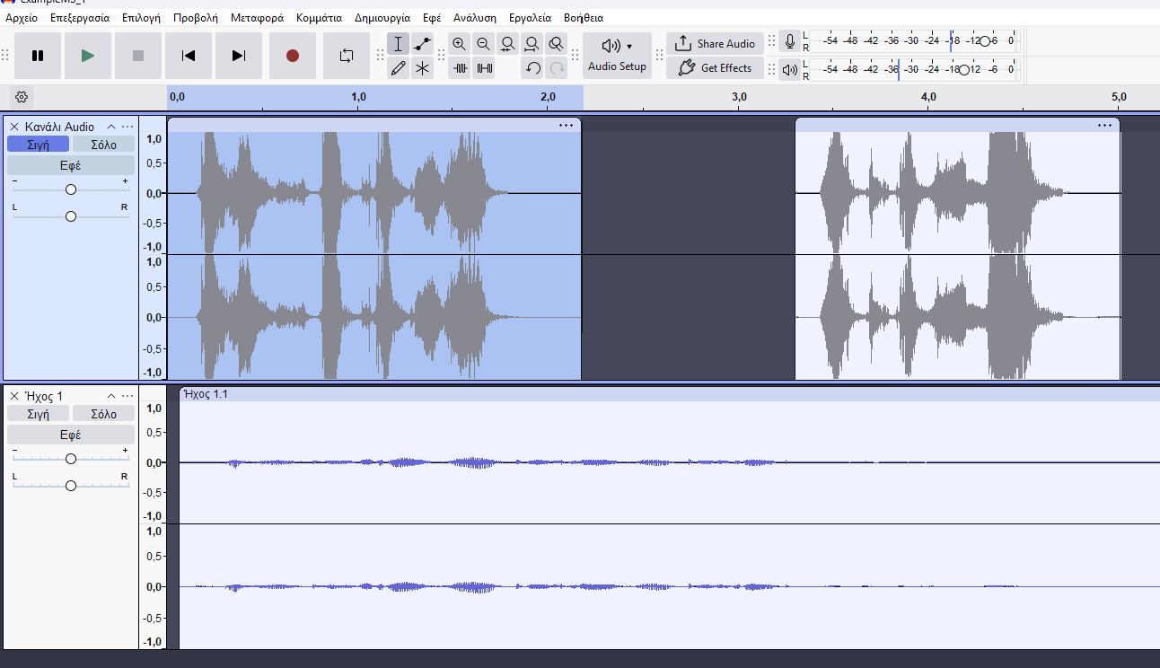
Audacity – Tracks
Each new audio source appears on a separate track
Tracks -> Add New -> Mono Track / Stereo Track
Give each track a suitable name
Adjust the volume or mute each track
Move audio along the timeline for correct synchronisation
Notes:
[Sources]
- pliroforiki_a_lykeiou_simeioseis_2023_2024(1).pdf, σελ. 72–73

Slide 5

Selecting a time range
Notes:
[Sources]
- pliroforiki_a_lykeiou_simeioseis_2023_2024(1).pdf, σελ. 72–73

Slide 6

Exercises
In class (Notes, pages 51–66)
1, 2, 3, 4 (pages 45–46)

